Slide 1
Town of Eden Bay
By: Nathan Chan, Jeff Holst, Cristian Johnson, Joe Scott

Slide 2
Introduction
Maintenance Department needs new information system
Current information system lacks:
Tracking expenses
Collecting information
Presentation
Prevents department from predicting future costs
Labor codes

Slide 3
RAVE
RAVE – new information system
RAVE will improve:
Expenses
Scheduling
Routine maintenance
Vehicle replacement
Labor codes
Efficiency
Department costs

Slide 4
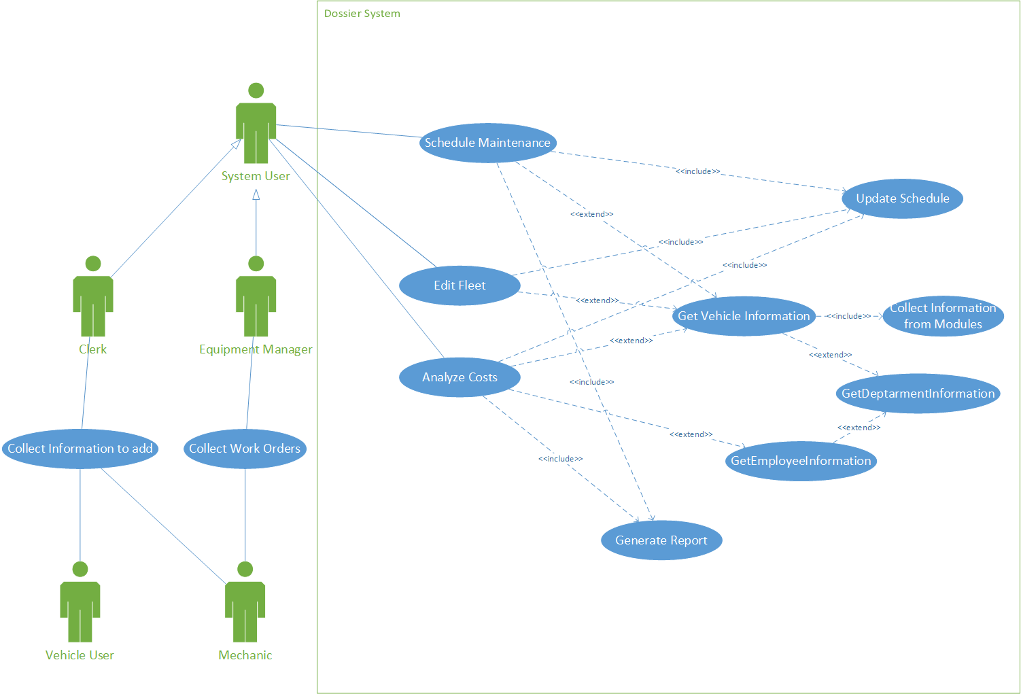

Slide 5
